Slide 1
Recommendations based on the MIND News Dataset
Elvin Medzhidov, Filippo Wang, Fabian Zorr,
Noah Croes, Sander Stokhof

Slide 2

The Microsoft MIND - Dataset

Slide 3
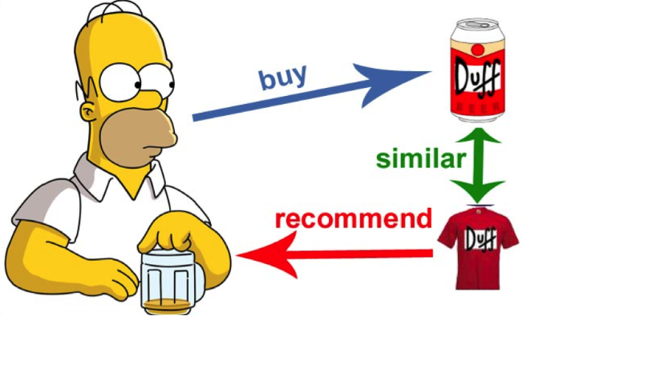
Individual Recommender System
Approach:
Content-based Collaborative Filtering
TF-IDF
Cosine Similarity
Scikit-Learn
Source: https://medium.com/tiket-com-dev-team/build-recommendation-engine-using-graph-cbd6d8732e46

Slide 4

Evaluation of the Individual RS
Precision

Slide 5
Evaluation of the Individual RS
Precision
Recall

Slide 6
Evaluation of the Individual RS
Precision
Recall
nDCG@K

Slide 7

Group Recommenders
Forming of the Groups
Group Recommendations
Approach:
Lenskit
Implicit Matrix Factorization
Source: https://www.freepik.com/free-vector/group-people-illustration-set_6969087.htm#query=people&position=3&from_view=keyword&track=sph

Slide 8
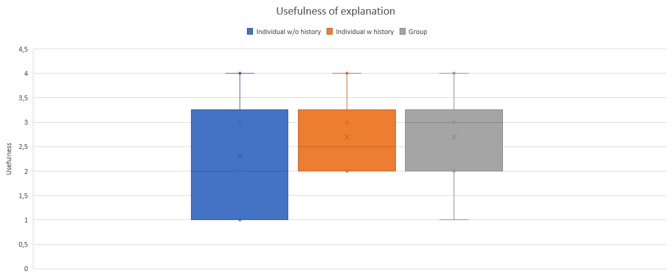
Evaluation of Explanations

